Slide 1
Marine Natural Products vs. Superbugs: A Molecular Docking Study

Slide 2
Background Of Project
Antimicrobial resistance (AMR) has emerged as a critical global health challenge, reducing the effectiveness of existing antibiotics and increasing the risk of untreatable infections [Kumar et al., 2025; Li et al., 2025].
In recent years, marine environments have gained attention as a rich source of bioactive compounds with potential therapeutic applications [Sharma et al., 2022].
Among marine pathogens, Vibrio vulnificus is particularly significant due to its ability to cause severe infections and its increasing resistance to multiple drugs [Oliver, 2010; Litwin & Calderwood, 2003].
This highlights the urgent need to explore novel compounds that can effectively target resistant bacterial mechanisms [Das et al., 2025].

Slide 3
Study Rationale
The genome of Vibrio vulnificus (accession: GCA_002224265.1) was analyzed to identify antimicrobial resistance (AMR) genes using the CARD database along with the RGI tool [Alcock et al., 2022]. The protein sequences corresponding to these resistance genes were then structurally characterized using AlphaFold2 and available data from the Protein Data Bank (PDB) [Thompson et al., 2004].
A marine-derived compound, Manoalide, was selected from the CMNPD and PubChem databases (CID: 6437368) based on its known bioactive properties [Sharma et al., 2022]. Molecular docking studies were performed using CB-Dock2 to evaluate the binding affinity of Manoalide against the identified AMR proteins.
Finally, the protein–ligand interactions were visualized using PyMOL, and the pharmacokinetic properties of the compound were assessed through SwissADME analysis to determine its potential as a drug candidate [Hyatt et al., 2010].

Slide 4
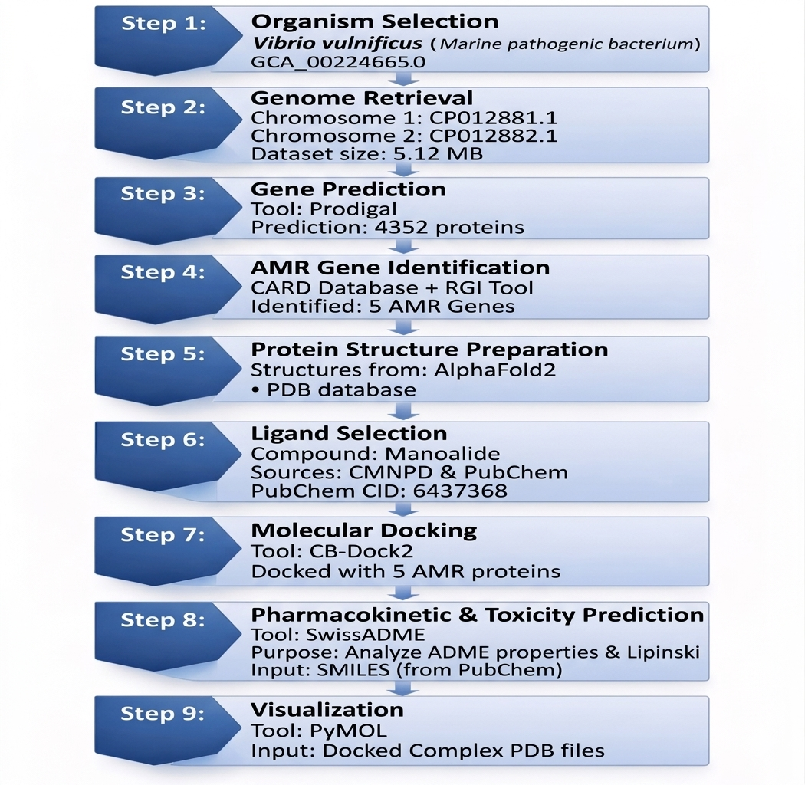
Workflow

Slide 5
Methodology
The study began with the retrieval of the complete genome sequence of Vibrio vulnificus (GCA_002224265.1), including Chromosome 1 (CP012881.1) and Chromosome 2 (CP012882.1), with a total size of 5.12 MB. Gene prediction was performed using Prodigal, resulting in 4352 protein sequences. These predicted proteins were analyzed using the CARD database along with the RGI tool to identify antimicrobial resistance (AMR) genes.
The identified AMR protein sequences were then structurally modeled using AlphaFold2 and available structures from the Protein Data Bank (PDB). A marine-derived compound, Manoalide found in the sponge Luffariella variabilis (PubChem CID: 6437368), was retrieved from CMNPD and PubChem databases, converted from SDF to PDB format, and prepared for docking.
Molecular docking was carried out using CB-Dock2 to evaluate binding interactions between Manoalide and AMR proteins. The docked complexes were visualized using PyMOL to analyze protein–ligand interactions, and finally, SwissADME was used to assess the pharmacokinetic and drug-likeness properties of the compound.

Slide 6
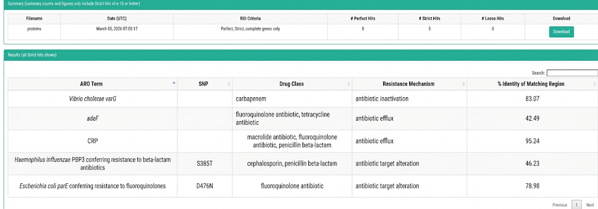
Results
Comprehensive Antibiotic Resistance Database(CARD)
The RGI analysis identified five strict antibiotic resistance gene hits with varying sequence identity. The dominant resistance mechanisms observed include antibiotic efflux and target alteration, suggesting intrinsic resistance potential within the analyzed dataset

Slide 7
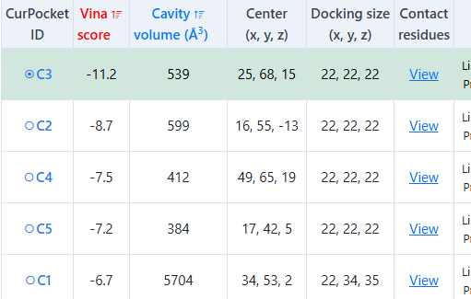
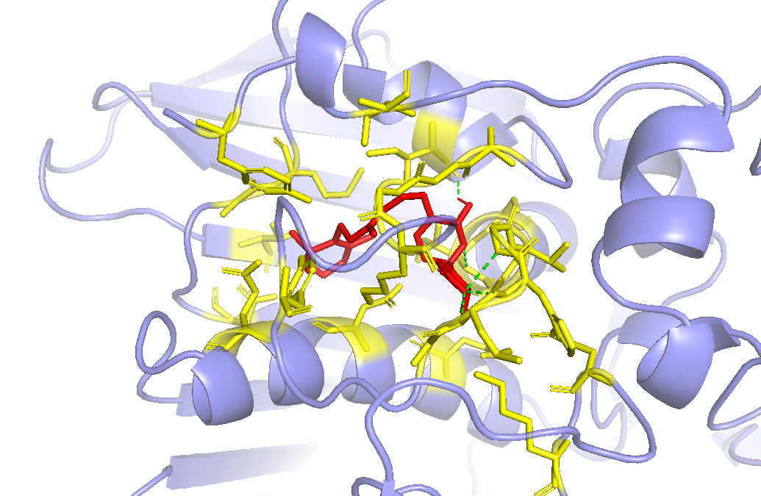
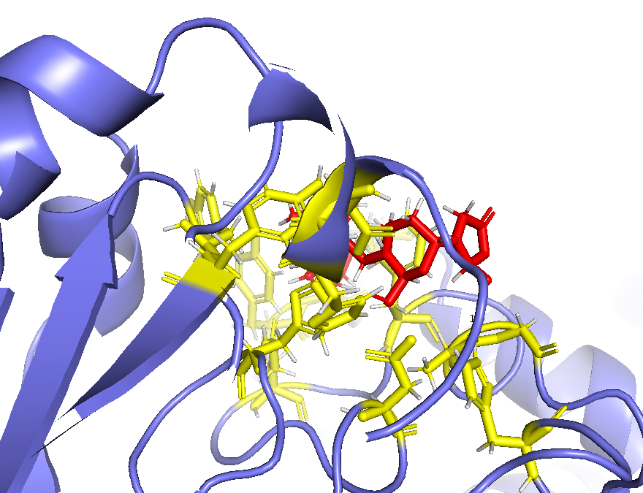
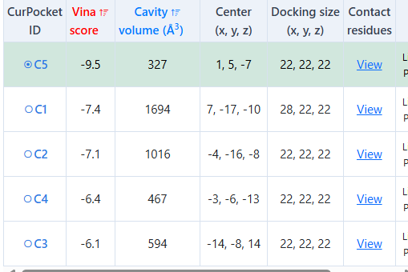
CB-dock2 tool result and Pymol visualization
PyMOL visualization
parE (Escherichia coli)
Strongest interaction observed with 4 hydrogen bond in parE protein (Vina score: −11.2 kcal/mol)
Vibrio cholerae varG
Manoalide demonstrated effective binding with Vibrio cholerae varG (Vina score: −9.5 kcal/mol)

Slide 8
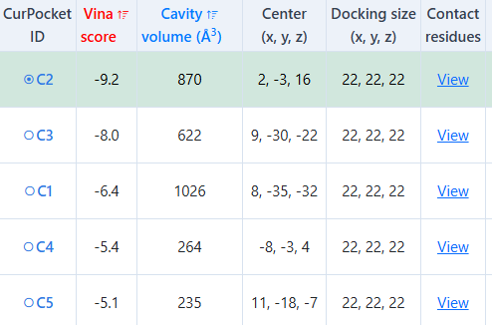
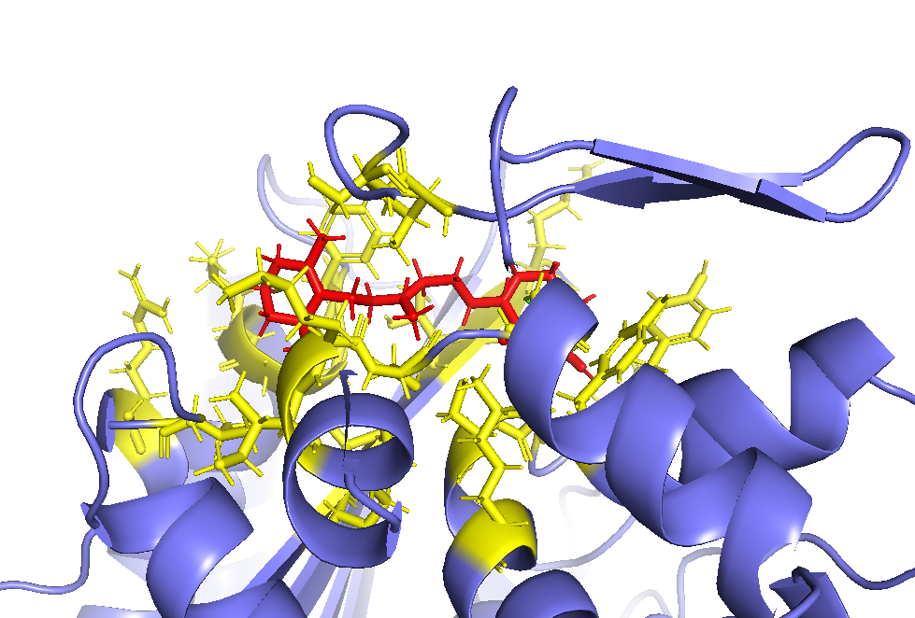
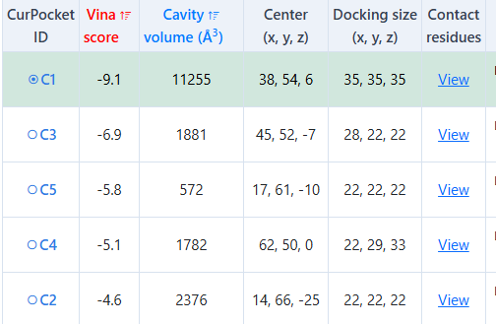
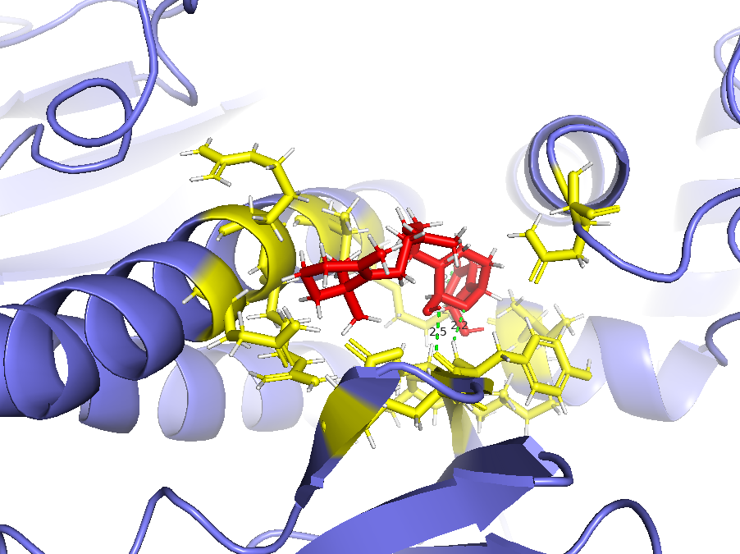
PyMOL visualization
PBP3 (Haemophilus influenzae)
High binding affinity observed with PBP3 target protein (Vina score: −9.2 kcal/mol)
cAMP Receptor Protein (CRP)
Manoalide showed strong binding affinity with 3 hydrogen bond with CRP protein (best Vina score: −9.1 kcal/mol

Slide 9
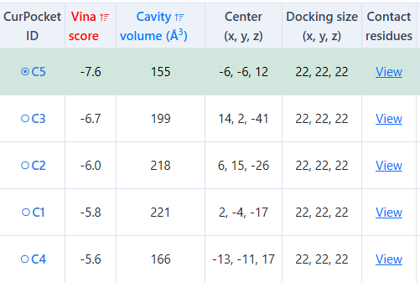
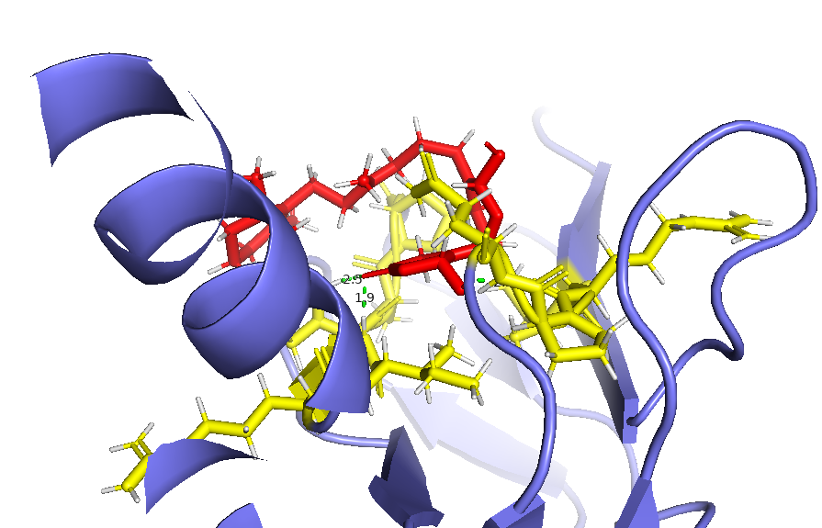
adeF
PyMOL visualization
Docking results indicate stable interaction with moderate binding energy (−7.6 kcal/mol
Strong binding affinity was observed with a docking score of −9.1 kcal/mol, indicating favorable interaction between the ligand and the target protein. A stable docking interaction was further confirmed with a binding energy of −7.6 kcal/mol, suggesting consistent ligand accommodation within the binding pocket. Notably, the highest binding affinity was recorded with the parE protein, showing a Vina score of −11.2 kcal/mol, highlighting it as the most promising target for inhibition.

Slide 10
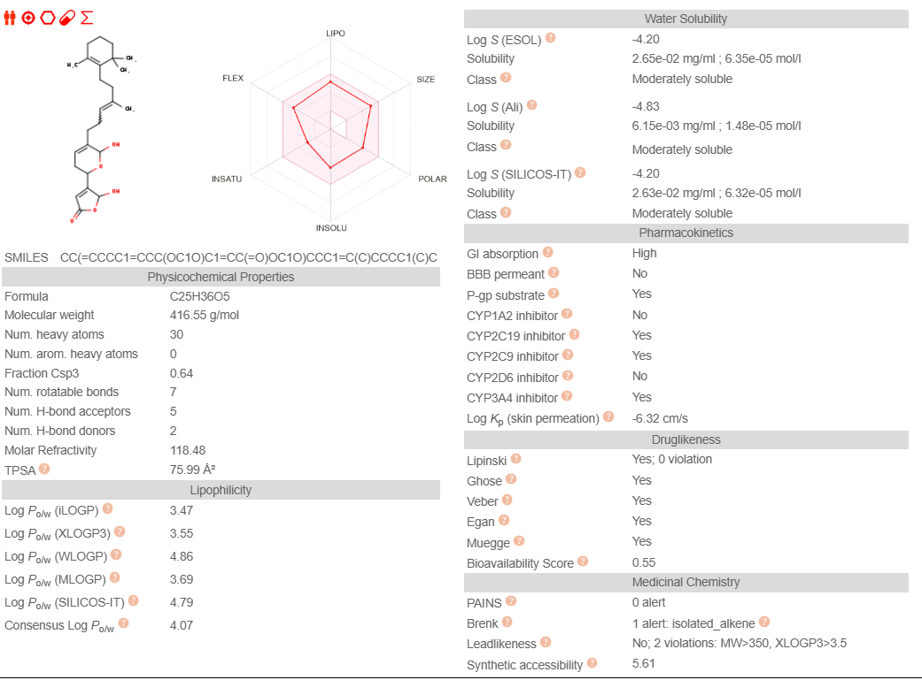
Manoalide in SwissADME
Lipinski Rule of Five
Molecular Weight ≤ 500 g/mol
LogP ≤ 5
Hydrogen Bond Donors ≤ 5
Hydrogen Bond Acceptors ≤ 10
Violations: 0 (Passed)
Molecular Weight: 416.55 g/mol
LogP (Lipophilicity): 4.07
Hydrogen Bond Donors: 1
Hydrogen Bond Acceptors: 4
Topological Polar Surface Area (TPSA): ~63 Å²
Lipinski Rule of Five: No violations
Gastrointestinal (GI) Absorption: High
Bioavailability Score: 0.55

Slide 11
Discussion and conclusion
Discussion
The identification of five AMR genes confirms the multidrug-resistant nature of Vibrio vulnificus. Molecular docking results demonstrated that Manoalide exhibits strong binding affinity toward these resistance proteins, particularly with the parE target. Interaction analysis further indicated stable binding within the active sites, while SwissADME results supported its favorable drug-like properties.
Conclusion
Manoalide shows strong potential as an inhibitor of AMR proteins, with high binding affinity and good pharmacokinetic properties. This study highlights the importance of marine natural products as promising candidates for developing new antimicrobial agents.

Slide 12
Reference
[1] Oliver, J.D. (2010). Wound infections caused by Vibrio vulnificus and other marine bacteria. International Journal of Infectious Diseases. https://doi.org/10.1016/j.ijid.2010.11.003
[2] Litwin, C.M., & Calderwood, S.B. (2003). Role of iron in regulation of virulence genes in Vibrio vulnificus. Infection and Immunity. https://doi.org/10.1128/IAI.71.10.5461-5471.2003
[3] Thompson, F.L. et al. (2004). Genomics and evolution of Vibrio species. FEMS Microbiology Reviews. https://doi.org/10.1016/S0168-6445(03)00064-0
[4] Kumar, R. et al. (2025). Antimicrobial resistance in marine ecosystems. https://doi.org/10.1007/s44351-025-00023-9
[5] Sharma, A. et al. (2022). Marine microbiology and AMR mechanisms. https://doi.org/10.1007/978-981-16-9723-4_6-1
[6] Das, S. et al. (2025). Environmental impacts on antimicrobial resistance. https://doi.org/10.9734/ijecc/2025/v15i125152
[7] Li, X. et al. (2025). Environmental pollution and AMR spread. Environmental Pollution. https://doi.org/10.1016/j.envpol.2025.126793
[8] Hyatt, D. et al. (2010). Prodigal: prokaryotic gene recognition tool. BMC Bioinformatics. https://doi.org/10.1186/1471-2105-11-119
[9] Alcock, B.P. et al. (2022). CARD database updates and AMR analysis. Scientific Reports. https://doi.org/10.1038/s41598-022-25026-3

